Slide 1
UIKIT Survey
6 views – label, image, text, table, navigation, tab
5 controls – button, segmented control, text field, slider, switch

Slide 2
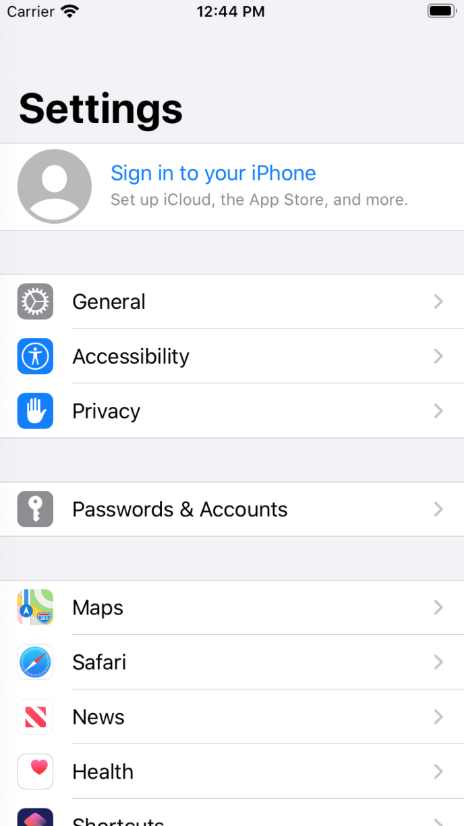
Label

Slide 3

Image View

Slide 4
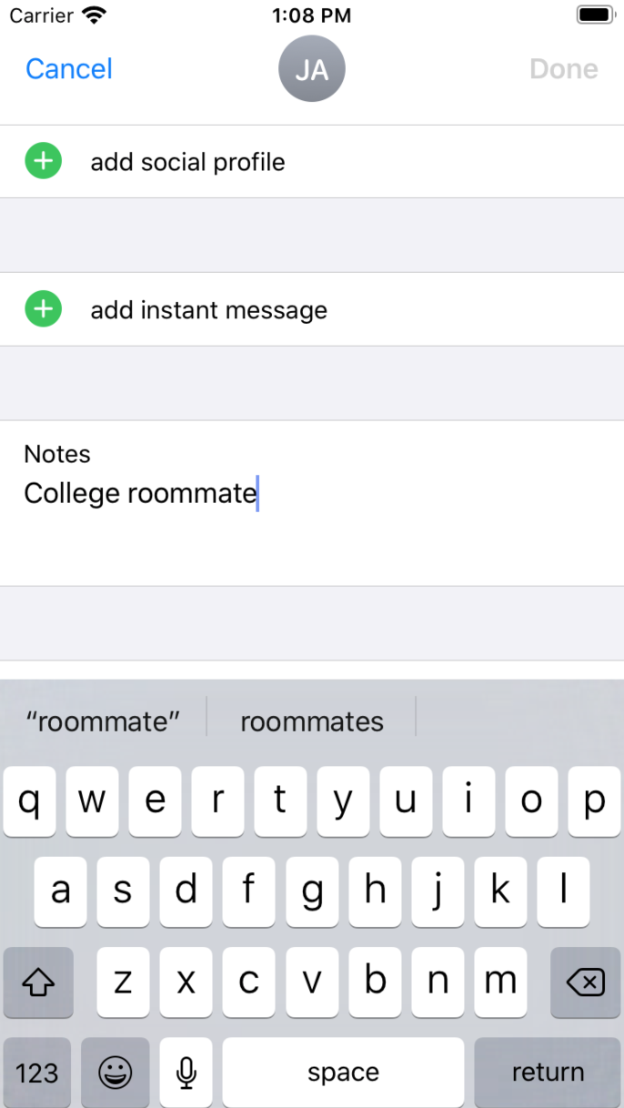
Text View

Slide 5
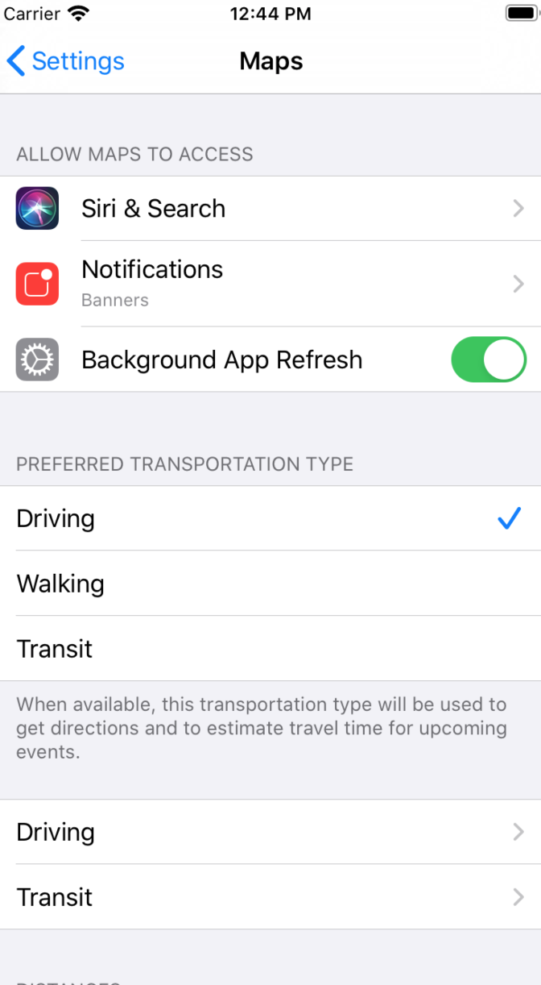
Table View

Slide 6
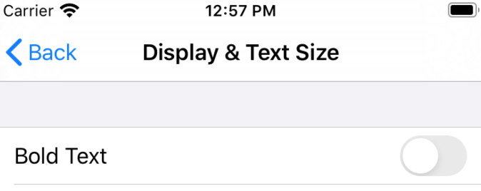
Navigation Bar

Slide 7
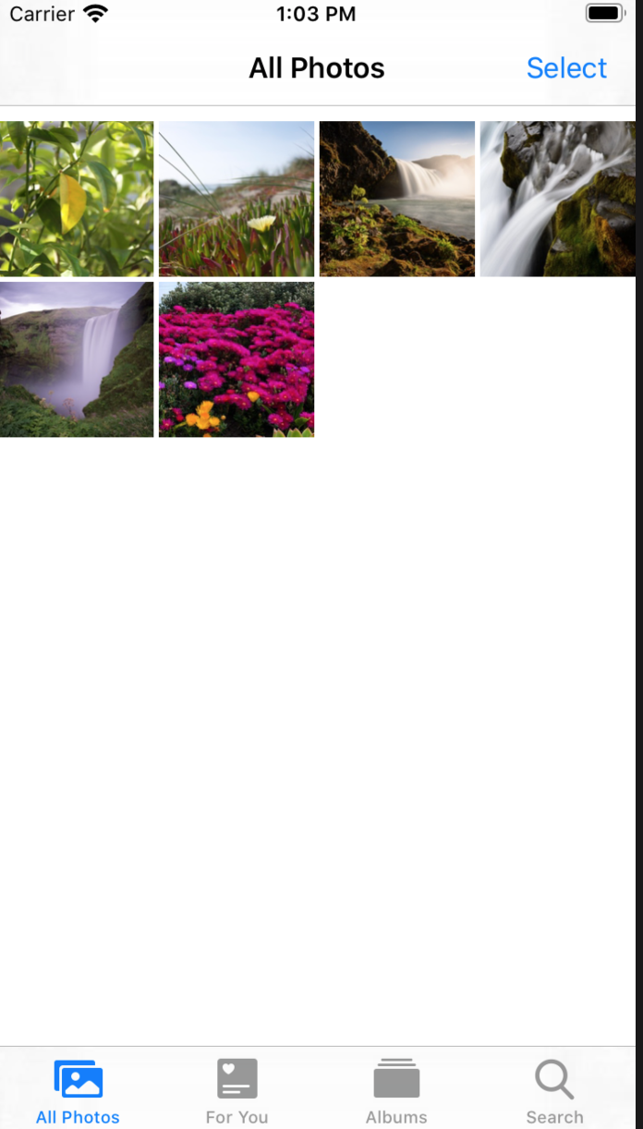
Tab Bar

Slide 8
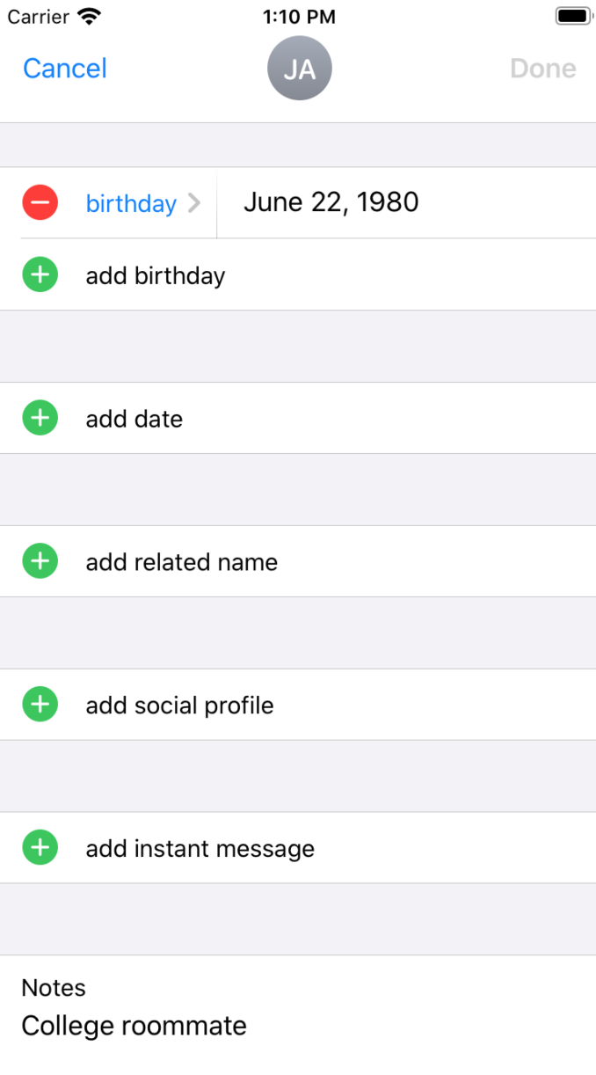
Button

Slide 9
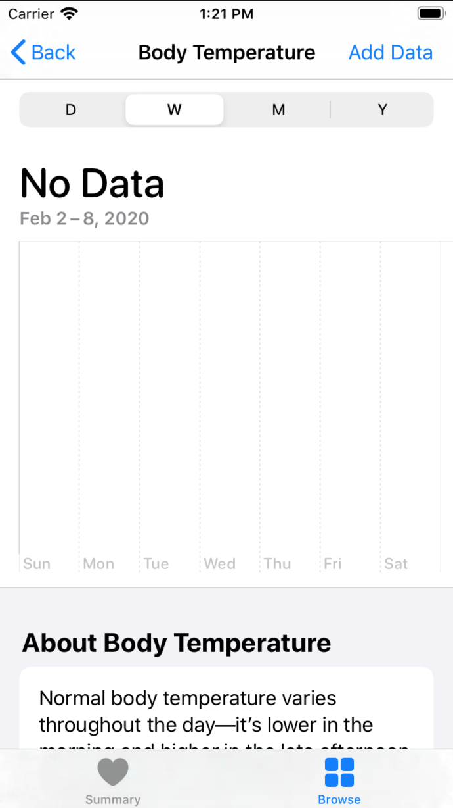
Segmented Control

Slide 10
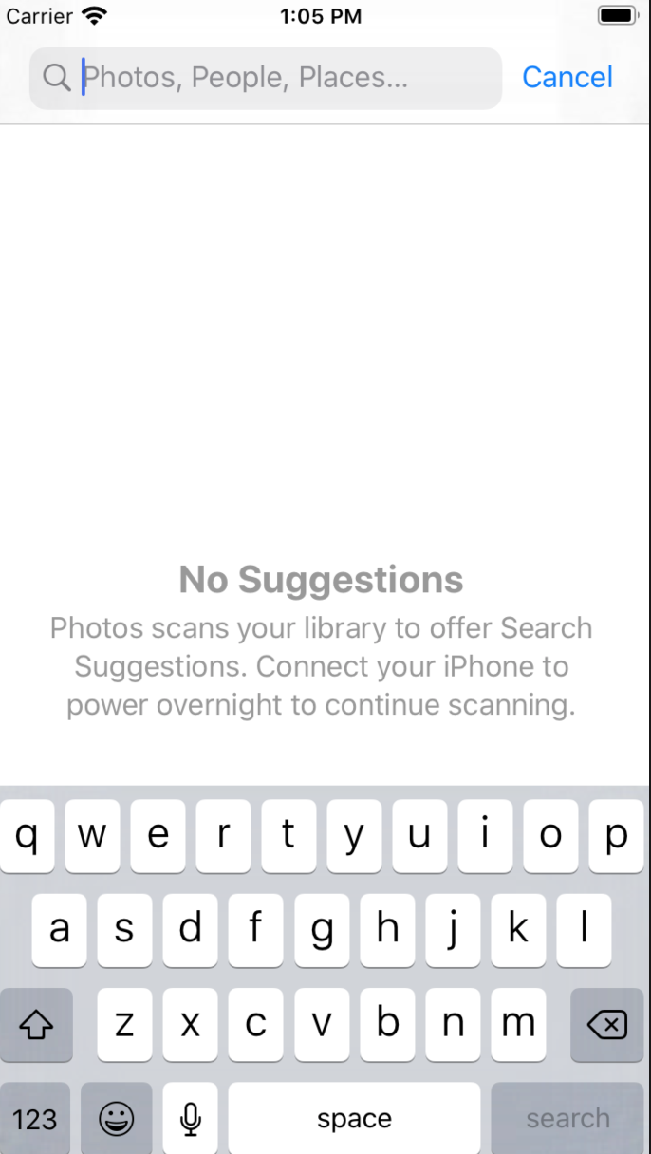
Text Field

Slide 11
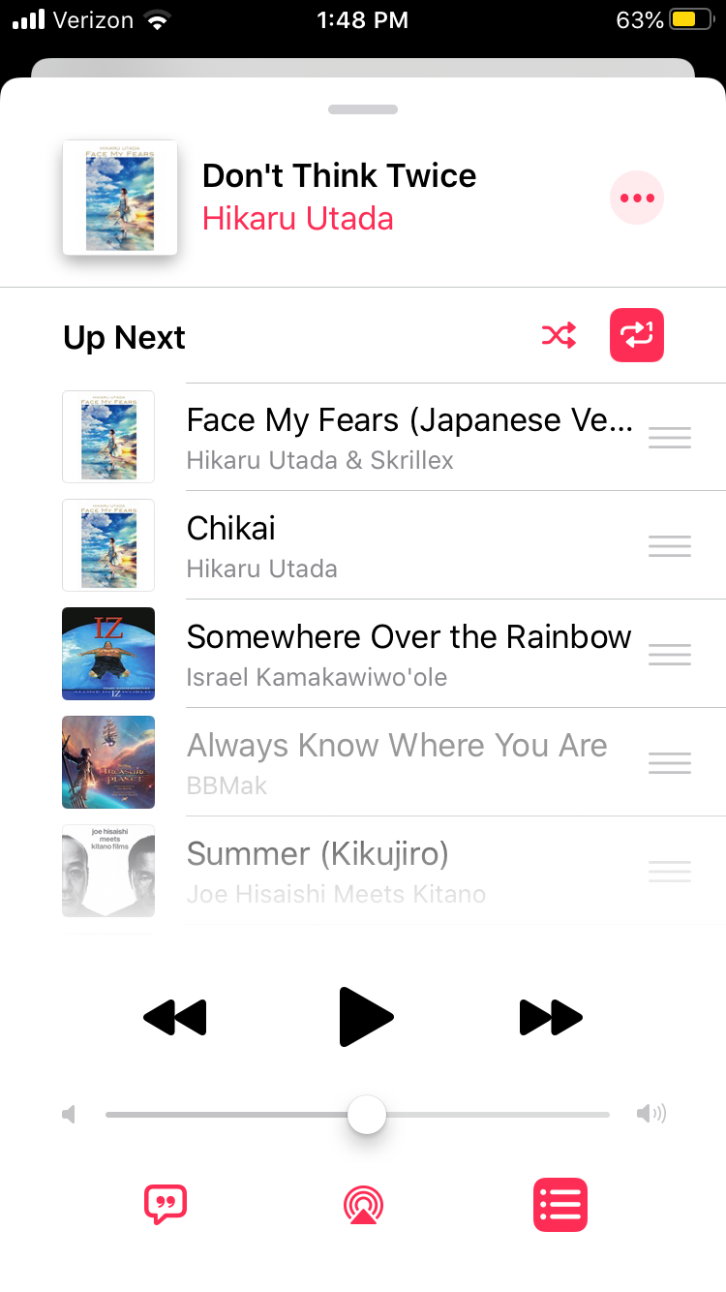
Slider

Slide 12
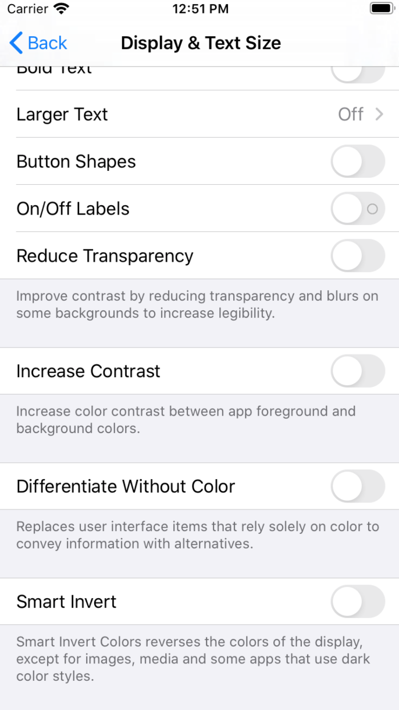
Switch

Slide 13
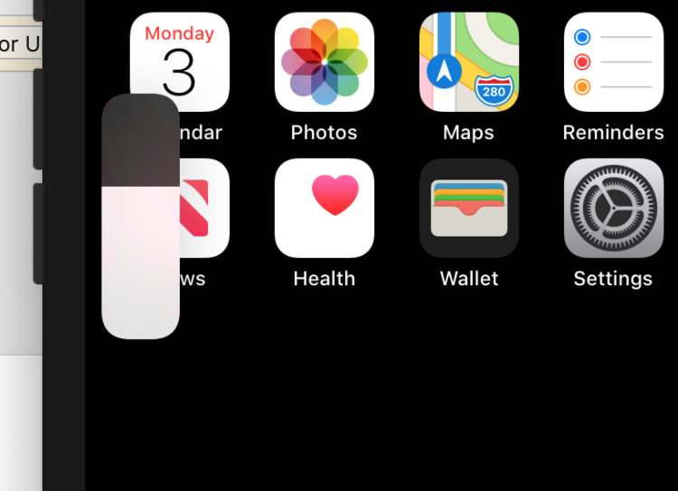
Unknown – Volume Slider?

Slide 14
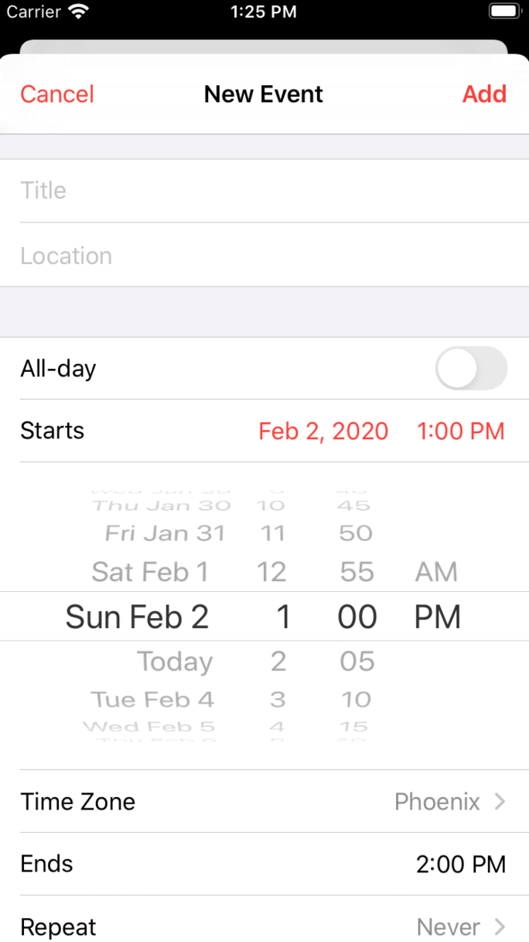
Unknown – Date Selector?

